Slide 1

AtliQ Hardware
Business Insights 360
A Power BI project designed to uncover key insights and drive data-informed decision-making.

Slide 2
Agenda
01 Introduction
05 Data Sources
02 Business Model
06 Data Model
03 Problem Statement
07 Report Overview
04 Objective
08 Strategic Recommendations

Slide 3
AtliQ Hardware is one of the fastest-growing companies in the electronics market operating throughout the globe.
AtliQ is leading manufacturer and supplier of computer hardware and selling products like PCs, printers, and accessories through channels & stores like Croma and BestBuy, as well as through platforms like Amazon and Flipkart.
Introduction

Slide 4
Business Model
AtliQ Hardware
Platforms
Brick and Mortar
Chroma
BestBuy
E-Commerce
Amazon
Flipkart
Channels
Direct
AtliQ E-Store
AtliQ Exclusive
Retailer
Chroma
Amazon
Distributor
Neptune

Slide 5
AtliQ Hardware has experienced rapid growth in recent years, establishing itself as one of the fastest-growing hardware companies. However, despite this success, the company has faced significant financial setbacks in the LATAM region, primarily due to ineffective decision-making based on Excel analyses, conducted surveys, and intuition-driven approaches.
Recognizing the need for data-driven strategies, the senior management now aims to integrate a dedicated Data Analytics team within the organization, leveraging Power BI to enhance decision-making capabilities and drive informed business outcomes.
Problem Statement

Slide 6
The goal of this project is to leverage Power BI to ensure data transparency and enable accurate, data-driven decision-making. With competitors expanding rapidly and intensifying market competition, it has become imperative to conduct precise data analysis and implement strategic, data-backed decisions to maintain a competitive edge.
Objective

Slide 7
Data Sources
MySQL Database
GDB041
Dim Customer
Dim Product
Dim Market
Fact Sales Monthly
Fact Forecast Monthly
GDB056
Manufacturing Cost
Pre Invoice Deduction
Post Invoice Deduction
Freight Cost
Gross Price
Excel Files
Market Share (xlsx)
AtliQ’s vs Competitors Market Share data
Operational Expenses (xlsx)
AtliQ’s Advertisement and Promotional Expenses data
Target 2022 (xlsx)
Key Metrics Target data for FY 2022

Slide 8
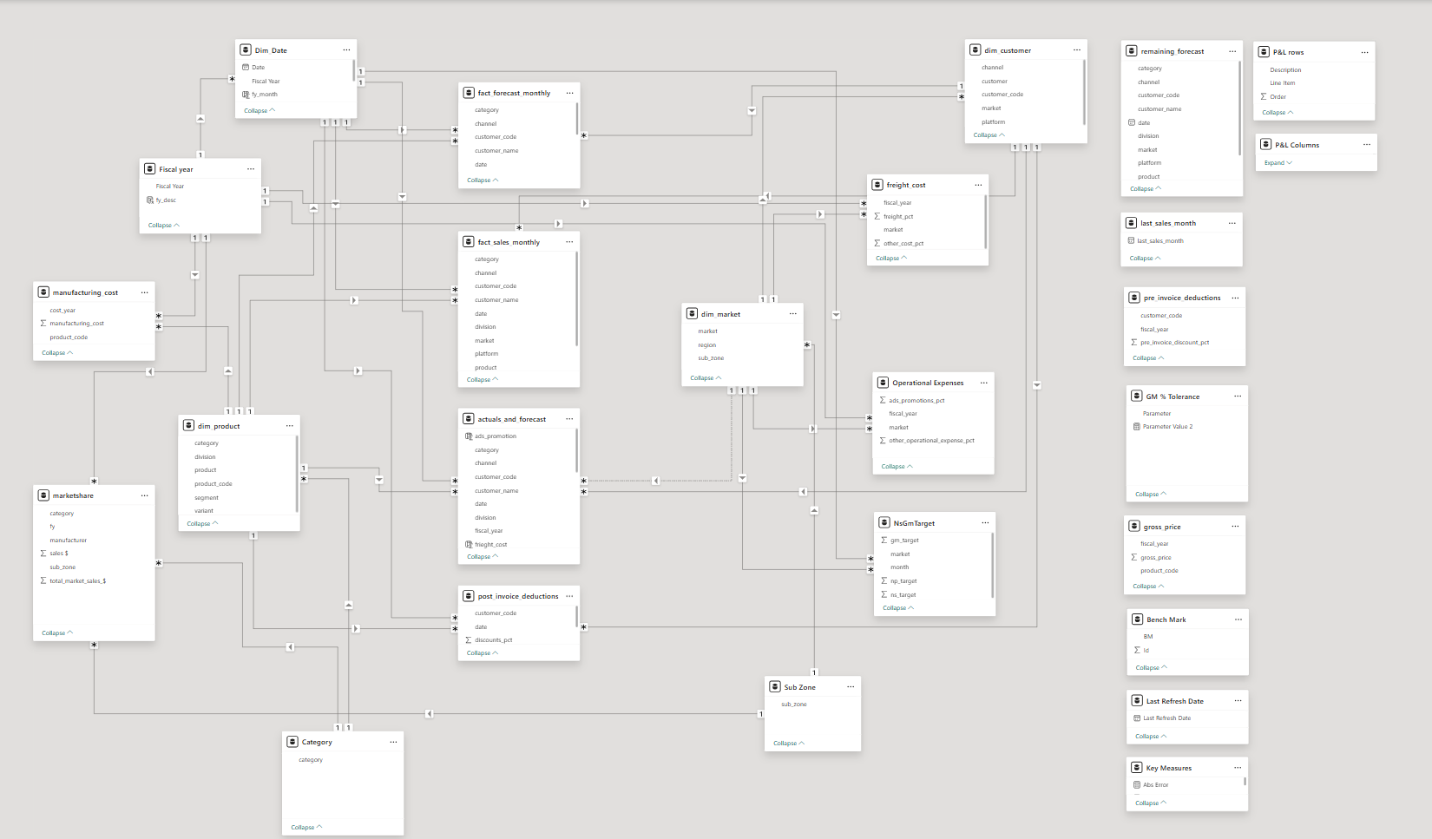
Data Model
We have Fact tables and the Dim tables fetched from the database.
Relationship has been established between the Dim tables and the Fact tables using Snowflake schema.
We have measures table that contains all the measures that were created within the scope of this project.
Also we have some supporting tables

Slide 9
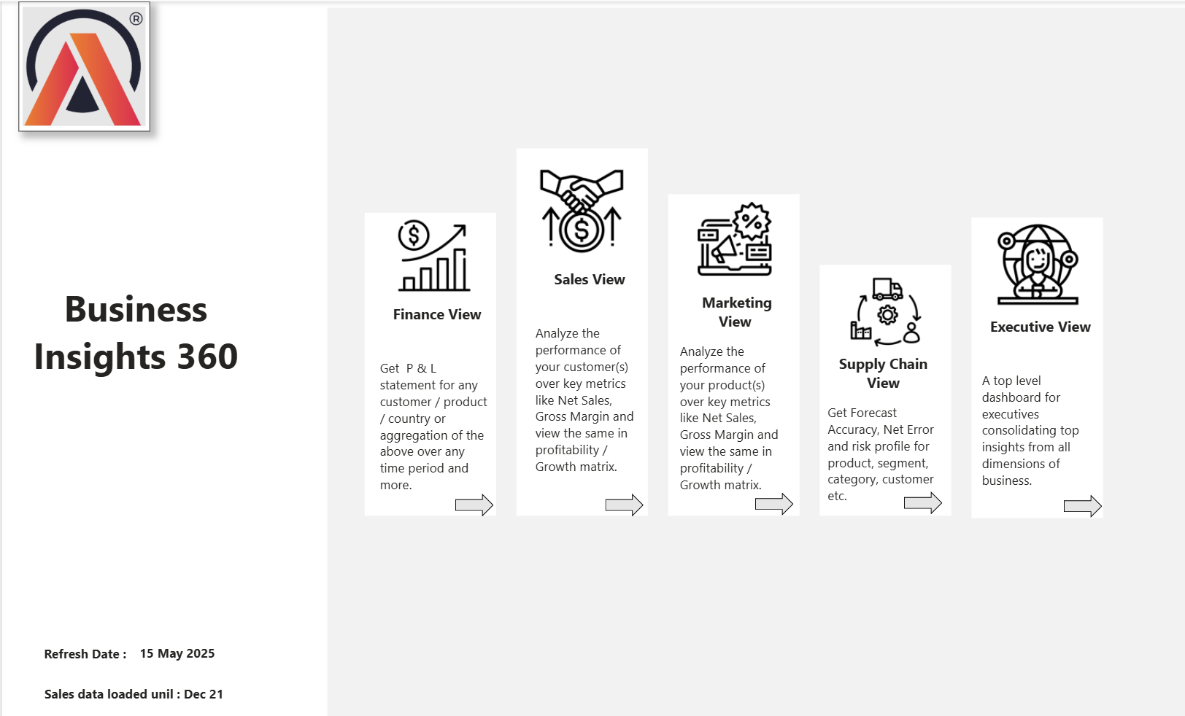
Report Overview – Home Page

Slide 10
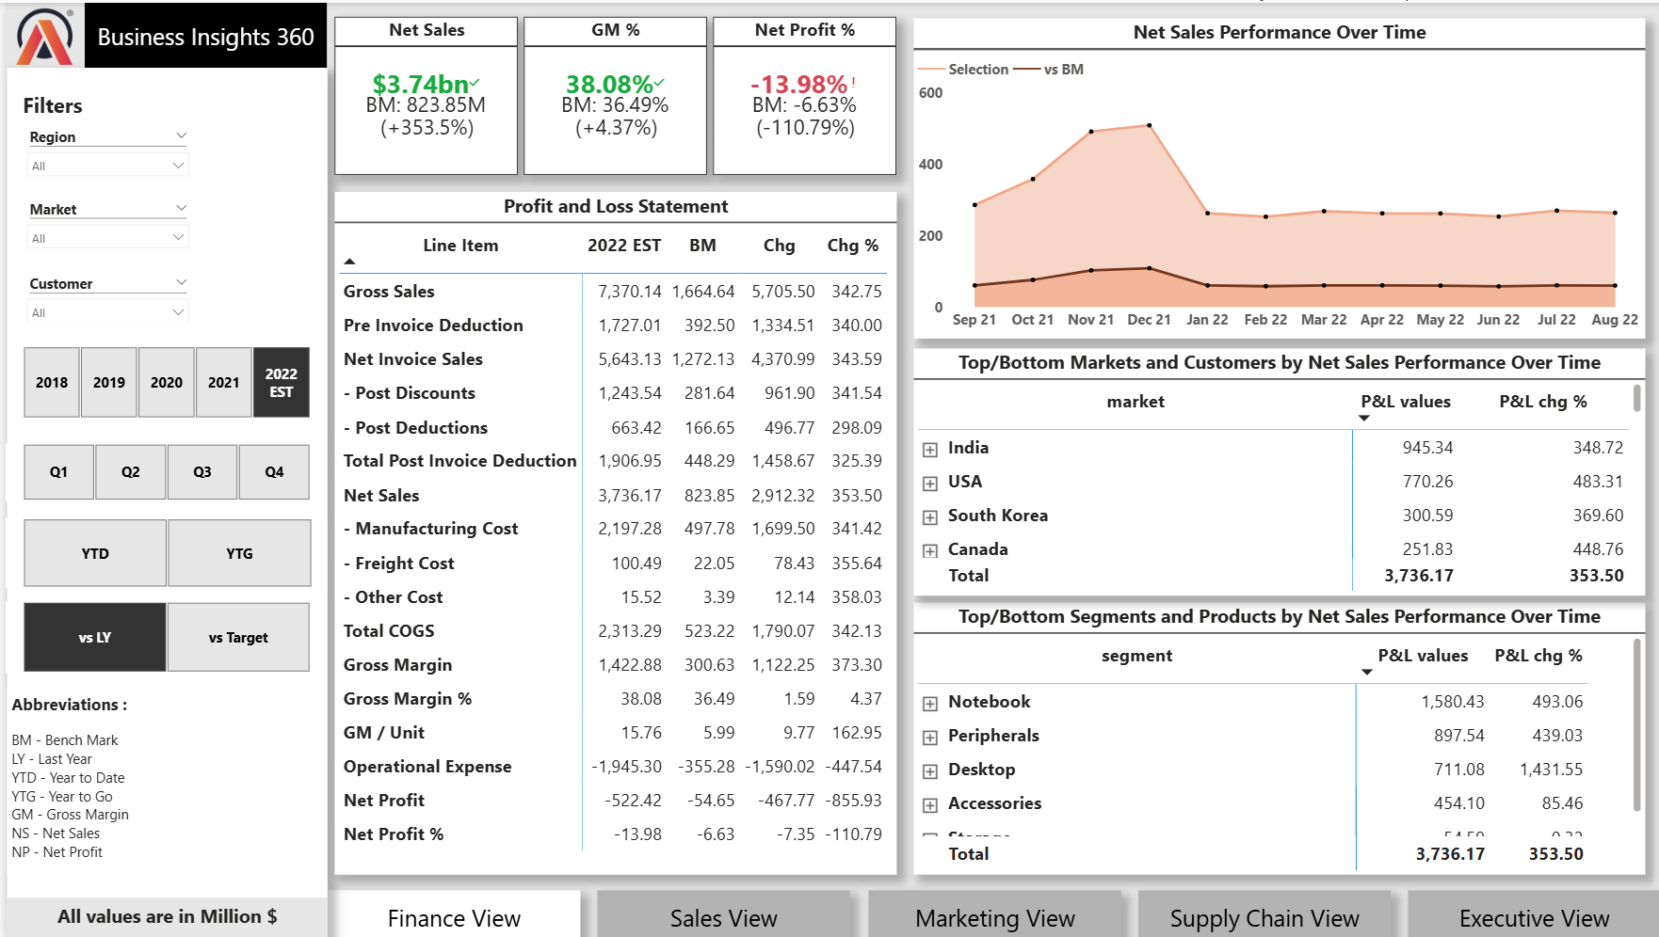
Finance Dashboard

Slide 11
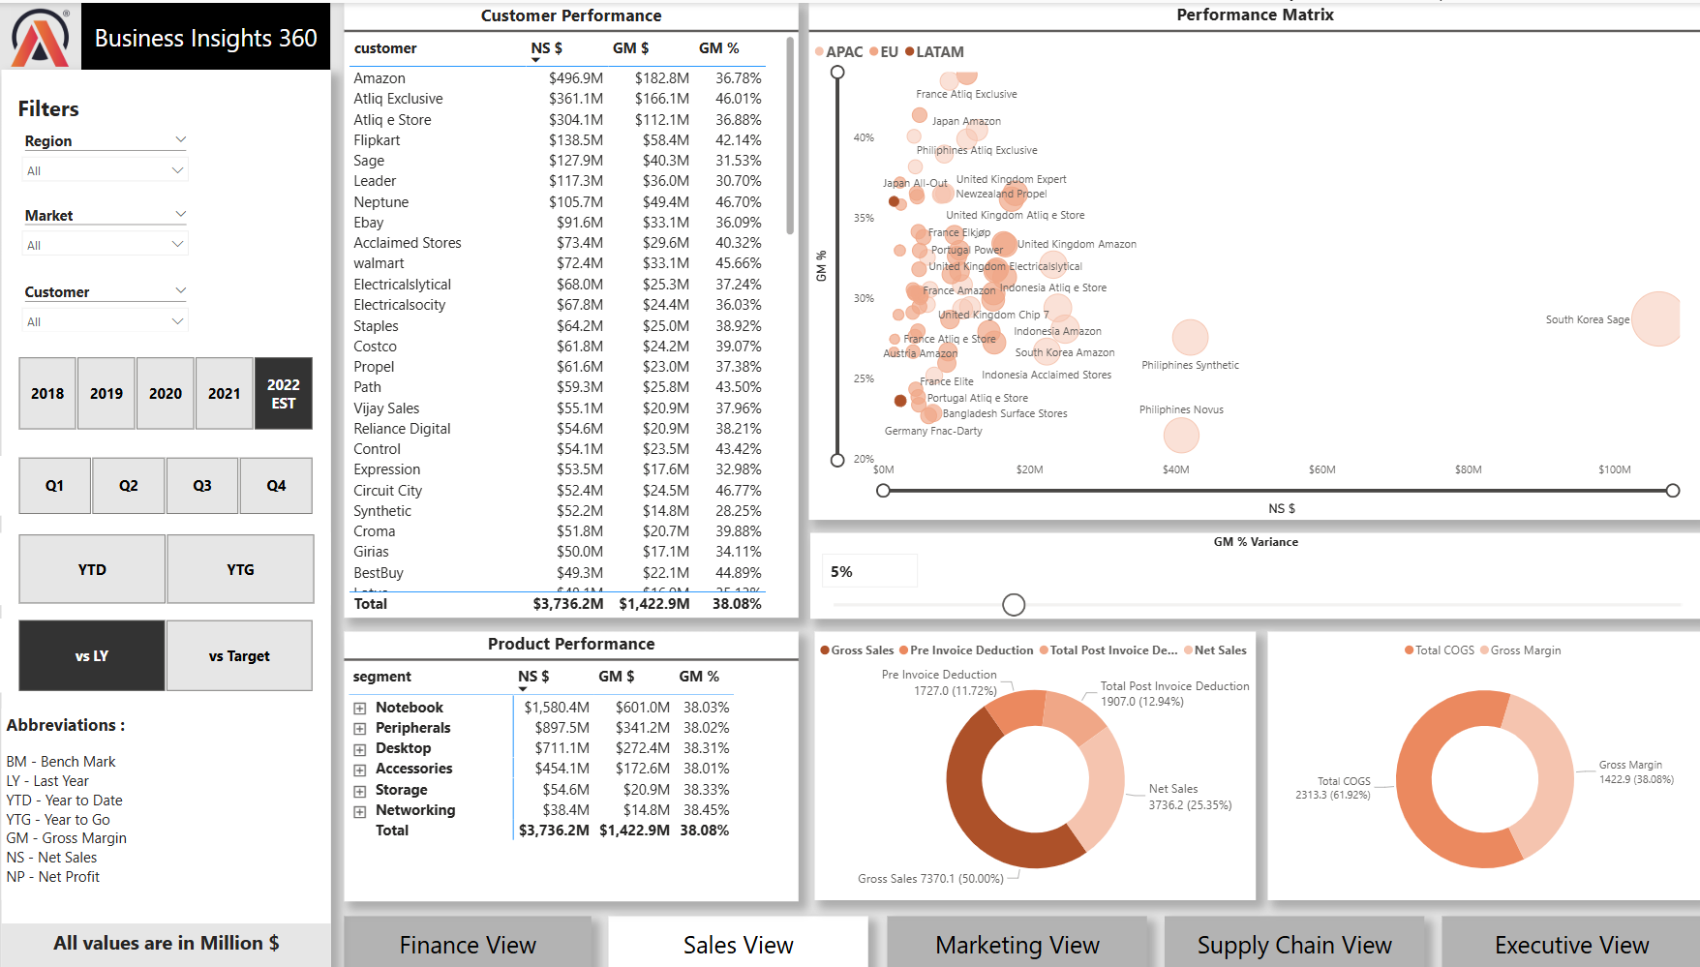
Sales Dashboard

Slide 12
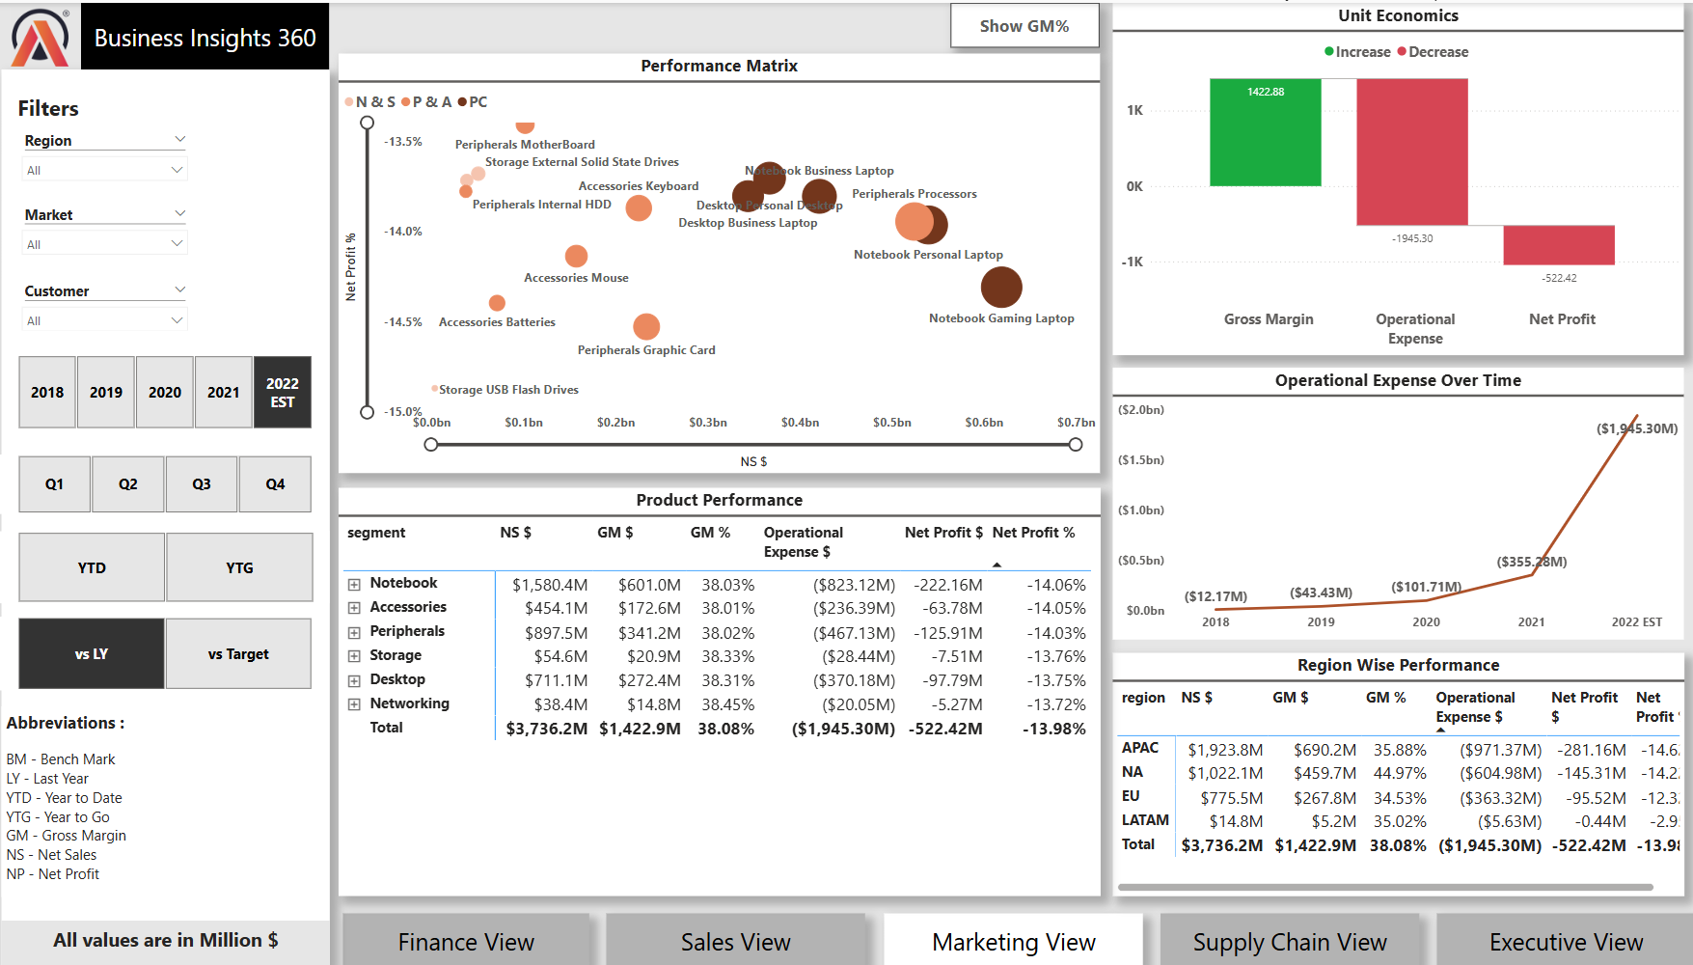
Marketing Dashboard

Slide 13
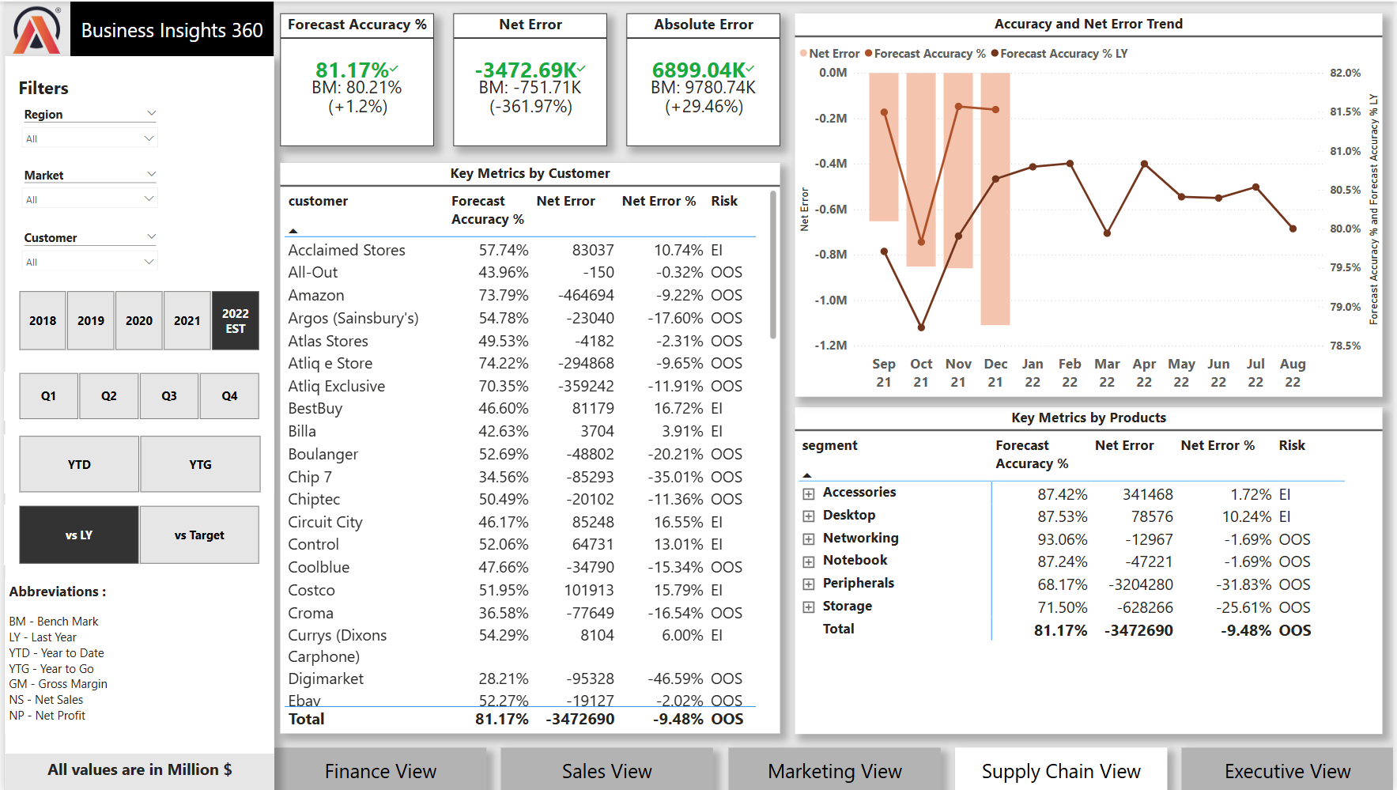
Supply Chain Dashboard

Slide 14
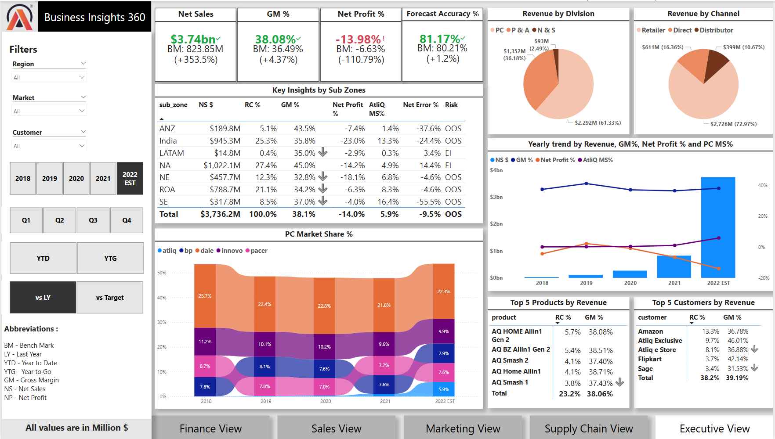
Executive Dashboard

Slide 15
Strategic Recommendations
Streamline Operational Costs: Identify areas for cost reduction to enhance financial efficiency
Market Expansion Strategy: Prioritize India and the U.S. as growth drivers while addressing weaker regions.
Balanced Growth Approach: Leverage strong-performing markets while restructuring strategies for underperforming regions.
Capitalize on High-GM% Segments: Optimize Networking and profitable segments to expand sales opportunities.
Increase Net Profit Margins: Adjust pricing models and promotions to balance expense reduction and revenue growth.
Enhance Forecast Accuracy: Implement advanced predictive analytics to align supply with real-time market demand.
Ensure Inventory Efficiency: Optimize inventory levels to reduce stock shortages while preventing excess storage costs.
Market Share Expansion: Strengthen AtliQ’s presence in India, while deploying recovery strategies for Latin America.
Profitability Recovery Initiatives: Focus on gross margin improvements, despite prior declines in net profit
By implementing these cross-functional strategic recommendations, AtliQ can achieve financial stability, operational efficiency, and sustained market growth.

